Slide 1

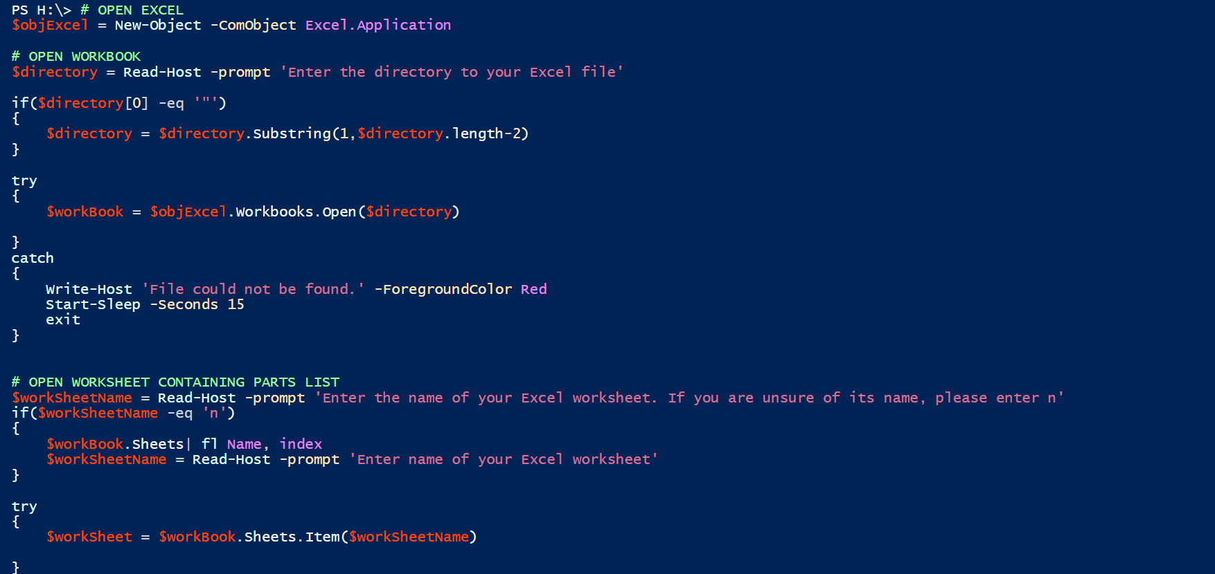
Automatic PDF Printer Instructions
Feb 2023

Slide 2
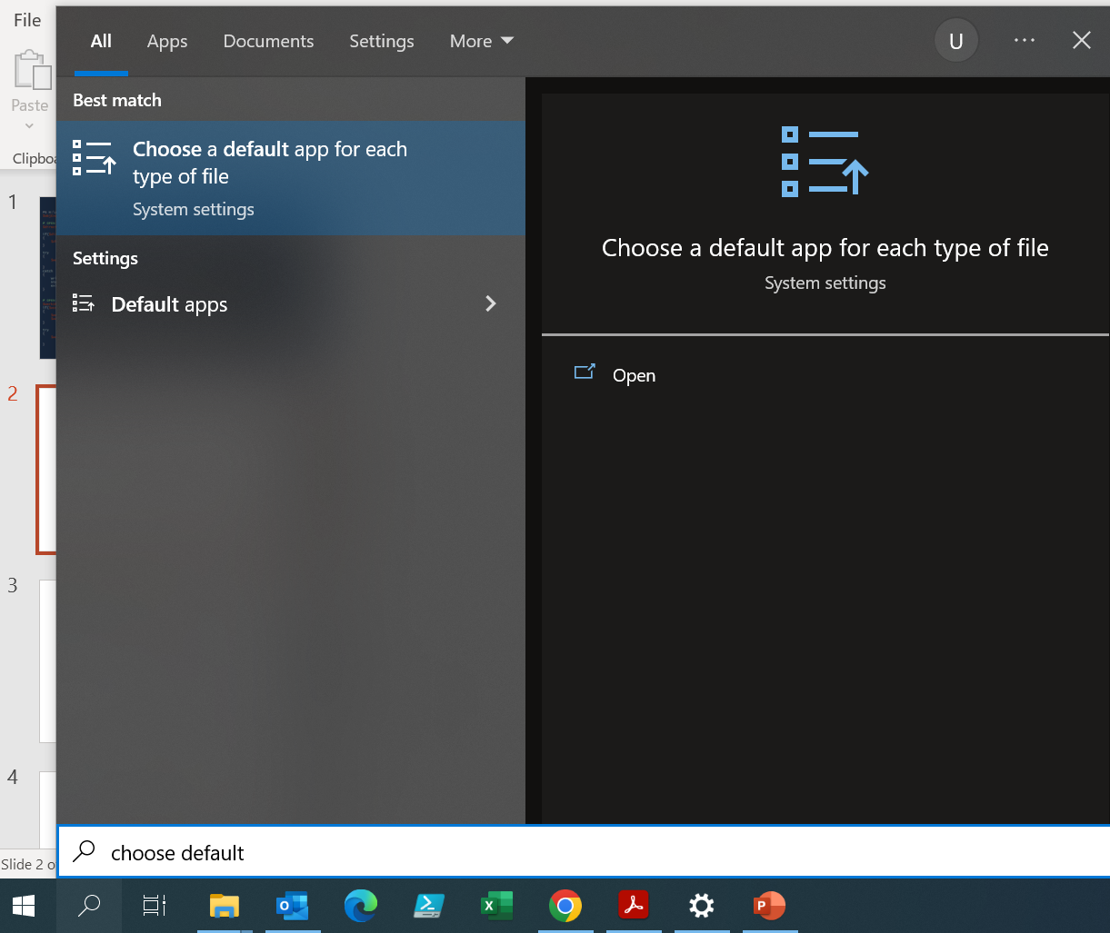
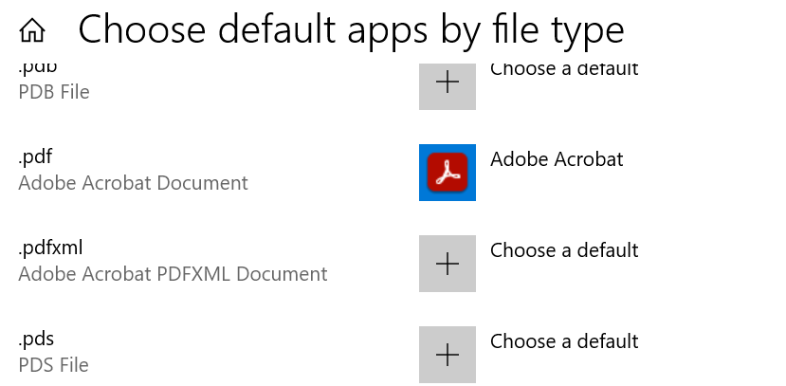
Before You Begin:
Notes:
Go to the search feature and type in “Choose a default app for each type of file”. Scroll down to the .pdf extension and ensure that “Adobe Acrobat” or “Adobe Acrobat Reader” is selected, not Microsoft Edge.

Slide 3
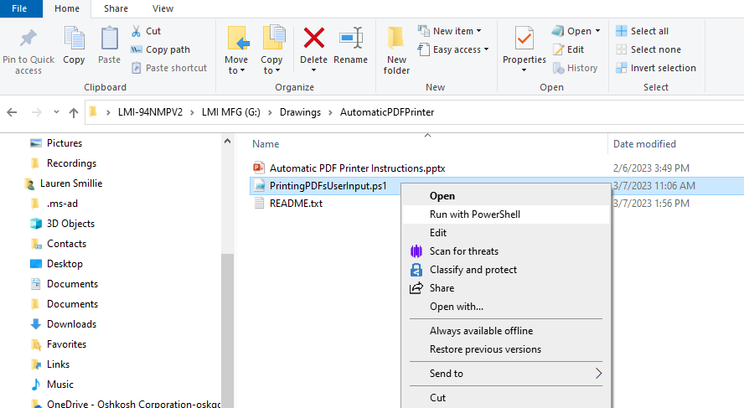
Open PowerShell File
Notes:
Open your File Explorer and navigate to the PowerShell program at "C:\_PowerShellScripts\PrintingPDFsUserInput.ps1“. Select “Run with PowerShell”.

Slide 4
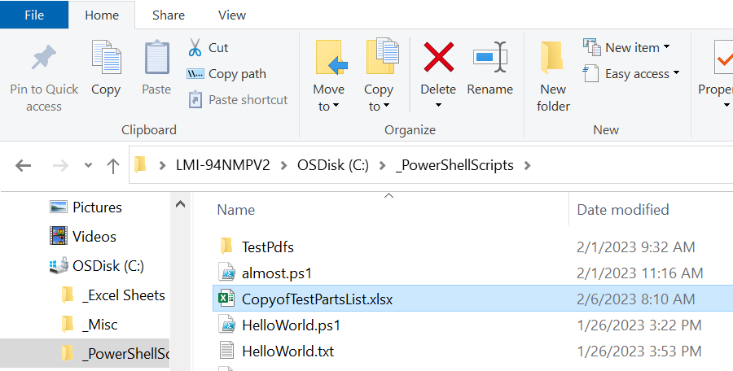
Find Directory to Excel File
Copy and paste the path into PowerShell
Notes:
When prompted, select your Excel file from File Explorer, and copy and paste the path into the program. Press enter to continue. NOTE: this program works best when the parts are broken into sheets of approx. 25 part batches.

Slide 5
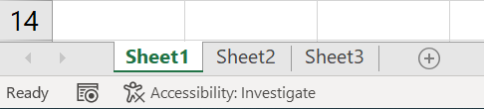
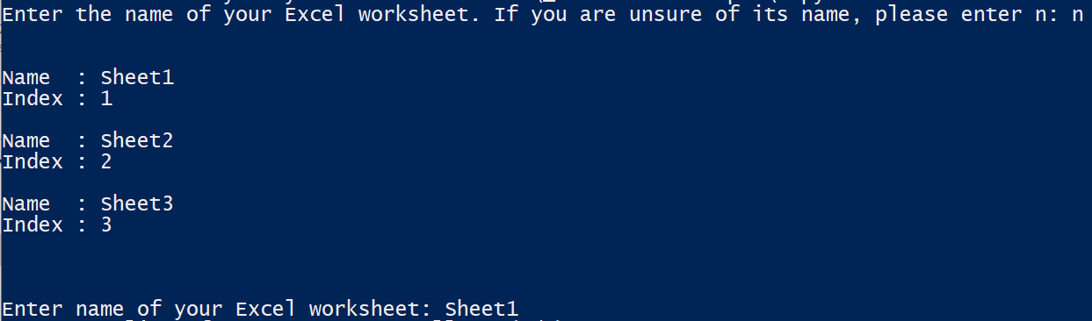
Find Your Excel Worksheet
Your different worksheet names
Notes:
The name of your Excel Worksheet can be found at the bottom left of an Excel file. You can also enter “n” to display a list of all your worksheet names.

Slide 6
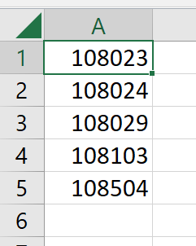
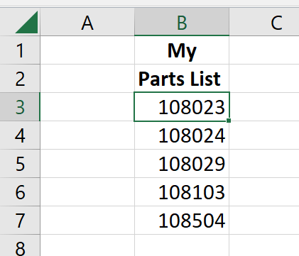
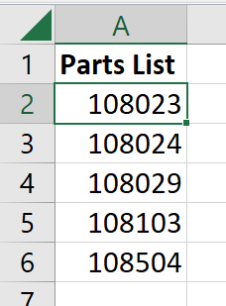
Enter Starting Row and Column
Starts at A1
Starts at A2
Enter “y”
Starts at B3
Enter “n”
Enter “n”
Notes:
If your parts list starts on A1, enter “y”.

Slide 7


Enter Starting Row and Column
Starts at B3
Starts at A2
Row = 3
Column = 2
Row = 2
Column = 1
Notes:
If you entered “n”, specify your row and column numbers. Remember to convert the lettered column into a number.

Slide 8
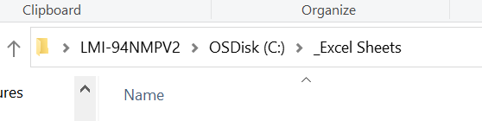
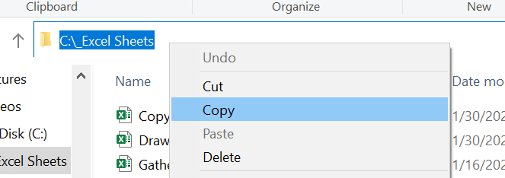
The Missing Parts File
The folder address
Notes:
Specify where you want to store a text file containing of all the parts that could not print. Go to File Explorer and right click on the top bar to copy the address. You can also manually type in the address. Do not include the name of the output file, just the address to place it in.

Slide 9
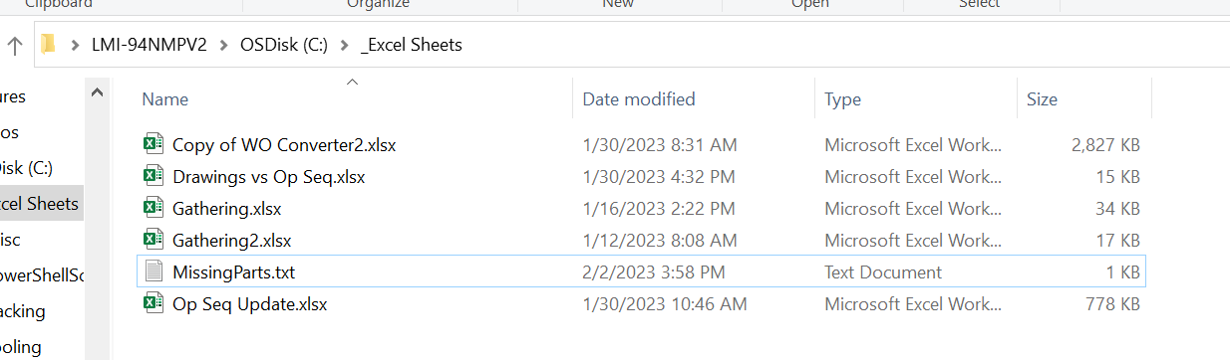
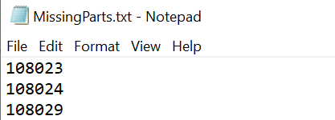

Open the MissingParts.txt file for a list of the part numbers that didn’t print.
The part numbers are also outputted in the PowerShell console.
Notes:
All missing parts can be found in the MissingParts.txt file that was created at the directory you specified. These drawings for these parts could not be found in LMIS.

Slide 10

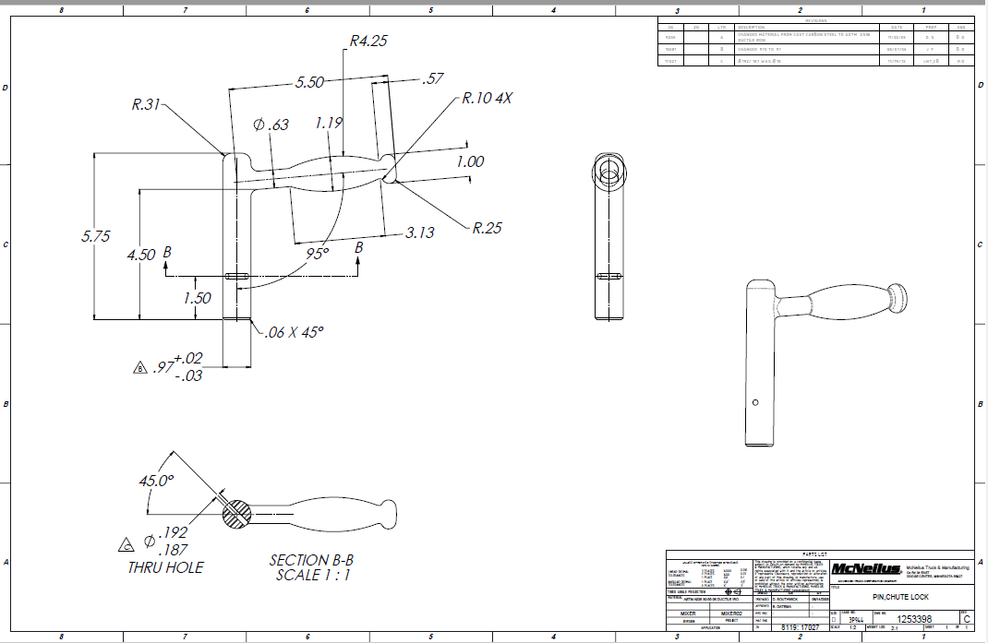
Retrieve Your Printed Files
All green files were successfully found and sent to your default printer.
Notes:
Collect your drawings from your default printer. If you are unsure, this can be checked by going to Settings>Devices>Printers & Scanners.

